Slide 1
Sumerian Achievements

Slide 2
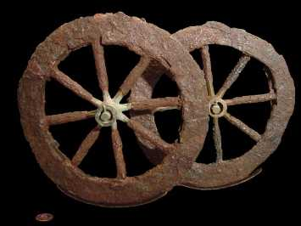
#1 The Wheel
Transporting goods from one location to another
Symmetrical component moving in a circular motion on an axis
It allowed them to travel and trade in different places. It also allowed them to carry heavier loads form place to place.

Slide 3
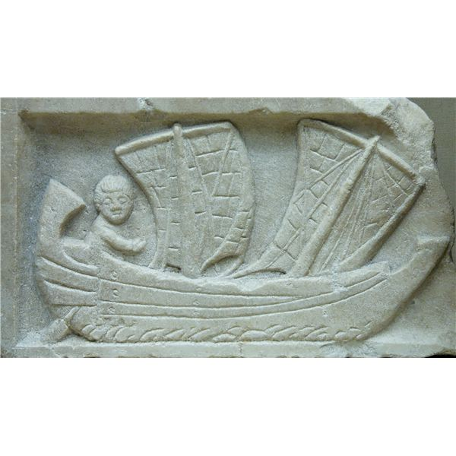
#2 The Sail
They needed a faster way to cross over the water
Utilized the wind to move a boat across the water
It allowed them to travel over water and trade for important items

Slide 4
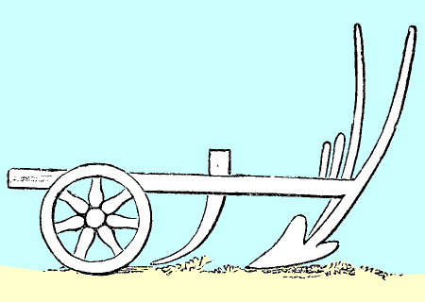
#3 The Plow
They needed a faster method of digging up the soil to plant seeds. The top soil was very hard.
A wheel and a sharp, pointed blade (stone) that cuts into the soil and turns it over.
It allowed them to plant quicker and easier than before. When they added oxen, it made it even easier.

Slide 5
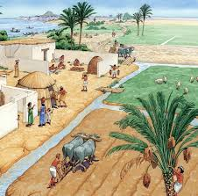
#4 Irrigation
It was very hot and dry in the summer and it was difficult to water their crops.
The Sumerians dug many miles of irrigation canals to carry water from the rivers to their fields.
It allowed them to have a surplus of food and grow a wide variety of crops.

Slide 6
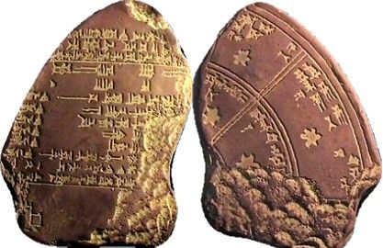
#5 Calendar
They wanted to know the right times for plowing, planting, and protecting against the floods, harvesting and other concerns.
Observed the stars and the movement of the sun across the sky
It helped them determine the right time for plowing, planting, protecting against floods, harvesting and other concerns.

Slide 7
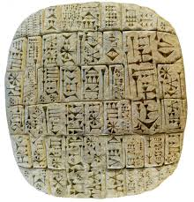
#6 Writing-Cuneiform
They wanted to record information
A stylus was used for this type of writing on clay tablets, cuneiform means “wedge shaped”
It allowed them to write about their civilization, record information, and use it for government notes. It also let them keep track of goods that were bartered.

Slide 8
Sumerian Achievements
Directions: Fill in the following chart with the achievements of Sumer.
1. What was the challenge? | 2. Invention that addressed the challenge | 3. How did the invention help the Sumerians?
#1
#2
#3
#4
#5
#6

Slide 9
Sumerian Achievements
Name _____________
Directions: Fill in the following chart with the achievements of Sumer.
1. What was the challenge? | 2. Invention that addressed the challenge | 3. How did the invention help the Sumerians?
#1
#2
#3
#4
#5
#6

Slide 10
Sumerian Achievements
1. What was the challenge? | 2. Invention that addressed the challenge | 3. How did the invention help the Sumerians?
Transporting goods from one location to another | Symmetrical component moving in a circular motion on an axis | It allowed them to travel and trade in different places. It also allowed them to carry heavier loads form place to place.
They needed a faster way to cross over the water | Utilized the wind to move a boat across the water | It allowed them to travel over water and trade for important items
They needed a faster method of digging up the soil to plant seeds. The top soil was very hard. | A wheel and a sharp, pointed blade (stone) that cuts into the soil and turns it over. | It allowed them to plant quicker and easier than before. When they added oxen, it made it even easier.
It was very hot and dry in the summer and it was difficult to water their crops. | The Sumerians dug many miles of irrigation canals to carry water from the rivers to their fields. | It allowed them to have a surplus of food and grow a wide variety of crops.
They wanted to know the right times for plowing, planting, and protecting against the floods, harvesting and other concerns. | Observed the stars and the movement of the sun across the sky | It helped them determine the right time for plowing, planting, protecting against floods, harvesting and other concerns.
They wanted to record information | A stylus was used for this type of writing on clay tablets, cuneiform means “wedge shaped” | It allowed them to write about their civilization, record information, and use it for government notes. It also let them keep track of goods that were bartered.
Answer Key

